Slide 1
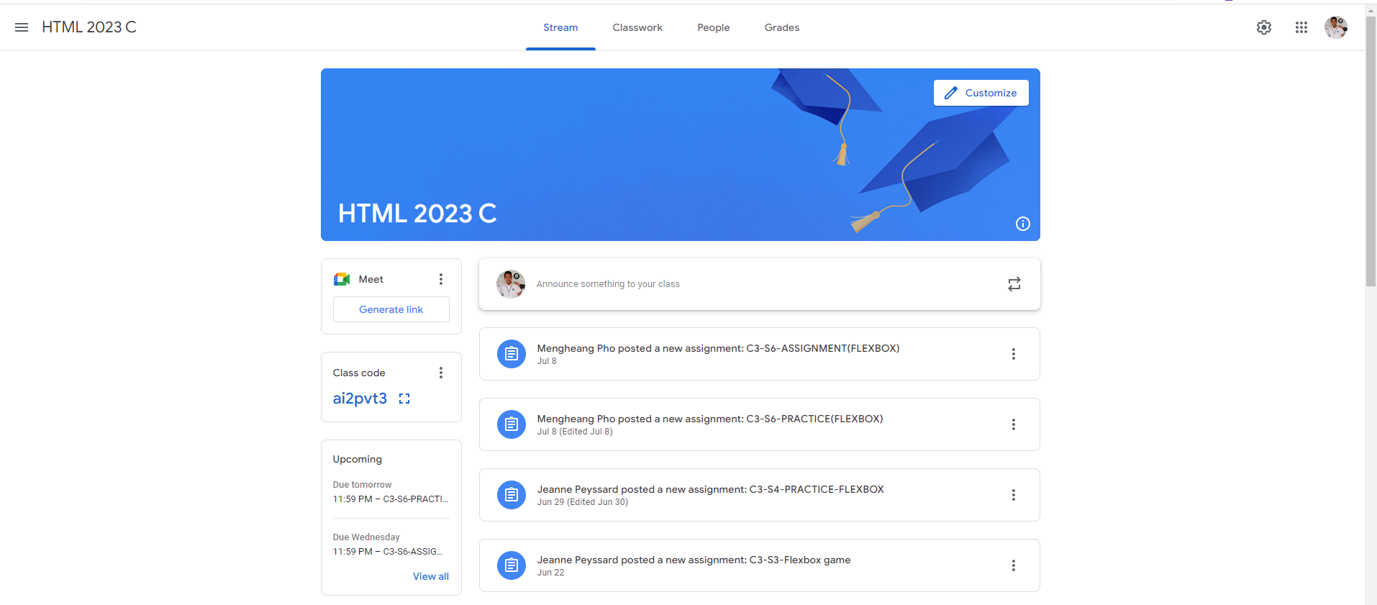
Identify root components of website below

Slide 2
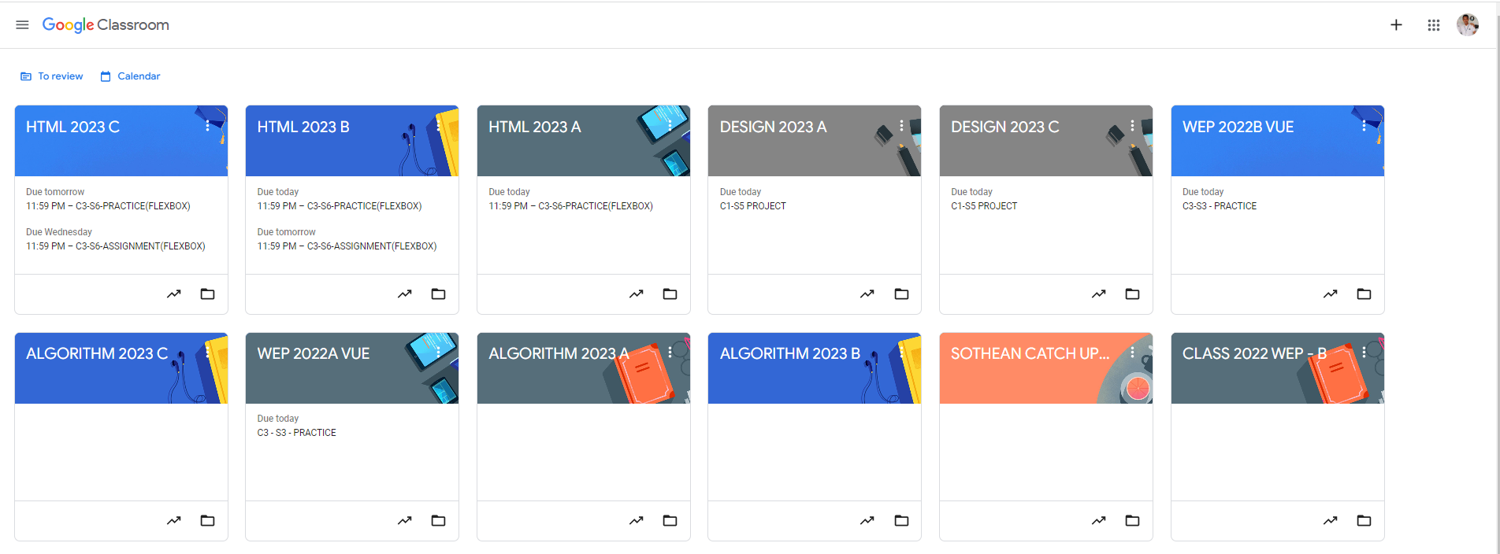
Root div
- Height: 100vh
content
nav
Flex: 0
header
Flex: 0
Flex: 1

Slide 3
Css Explanation:
To structure this mockup using CSS flex containers, here is a breakdown of how you might organize the flex containers based on the layout shown in the image.
Top-Level Container (main-container): This container will hold everything within the page, including the navigation bar and main content. It should use display: flex; flex-direction: column; to stack elements vertically.
Navigation Bar (nav-bar):
This would be a flex container for the navigation items like the menu icon, course name ("HTML 2023 C"), tabs (Stream, Classwork, etc.), and profile icon.
Set it to display: flex; align-items: center; justify-content: space-between; to align items horizontally and spread them across the container.
Main Content Container (content-container):
This container will hold the banner and the posts/announcements sections.
Use display: flex; flex-direction: column; to stack the banner on top of the announcements section.
Banner (banner-container):
Place the banner within a flex container, potentially with an inner flex for items like the "Customize" button.
Set to display: flex; align-items: center; justify-content: space-between; to position elements within the banner horizontally.
Announcements and Links Container (announcements-container):
This container should hold the "Meet" button, "Class code," and the list of posts or announcements.
Use display: flex; flex-direction: column; to arrange the items vertically.
Announcements List (posts-list):
Each post or announcement (like assignments or announcements) would be a flex item within this container.
Set each individual post to display: flex; align-items: center; to align icons and text properly.
Each of these container names (e.g., main-container, nav-bar, content-container, etc.) can be adjusted to suit your naming conventions, but this structure should help you reflect on the needed flex containers and their hierarchy. Let me know if you'd like more details on any specific part!

